Slide 1
Correlation of us Border entries and trade
Philip Ayazi & Taylor Walraven November 2019

Slide 2
Motivation AND SUMMARY
Cores Message / Hypothesis:
What stories are shown by border crossings data?
Why this topic?
Both trade and immigration are political hot-button issues. We wanted to see how many people and how much freight is entering the country at the land borders and see the trends in each over the past two decades.

Slide 3
Questions and Data
Which US border has more freight and people entering through it? Are there any shifting trends between US states?
Has the amount of freight and number of people entering the country increased over time? Does this correlate with observed trade data over the same time period?
Are there any dramatic shifts in border entries that can be explained by historical events?
Border Crossing Entry Data https://www.kaggle.com/akhilv11/border-crossing-entry-data
Correlates of War Project: Bilateral Trade https://data.world/cow/bilateral-trade

Slide 4
Data cleanup and exploration
Describe the exploration and cleanup
The Correlates of War (COW) data contained trade flow amounts per year in USD for many countries, so we isolated the data for the US trade with Canada and Mexico.
The Border Crossing Entry data reflects the count of people and freight containers that enter the country at each Port of Entry along the borders by month over about 2 decades.
We aggregated the Border Crossing Entry data by border and year to allow for comparison between borders across time, as well as to compare it to the COW data.
Discuss insights attained while exploring data that weren’t anticipated
Truck containers began pouring into the US at Detroit and Buffalo after NAFTA’s enactment
Individuals entering the US from Mexico declined steadily from 2000 to 2011, but has grown since
Problems that arose after exploring the data, how we resolved them:
2019 data needed to be excluded as we chose to analyze year by year

Slide 5
Data analysis
Steps taken to analyze the data and answer questions
Read data from csv files into Pandas DataFrames in python
Isolate COW trade data between US and its neighboring countries
Aggregate Border Crossing Data by Border, State, Year, and Port of Entry
Remove data from years not relevant to our study or which have incomplete data
Interesting figures developed during analysis:

Slide 6
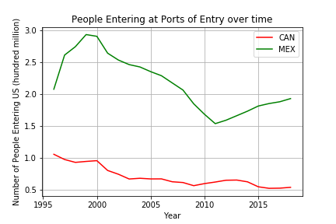
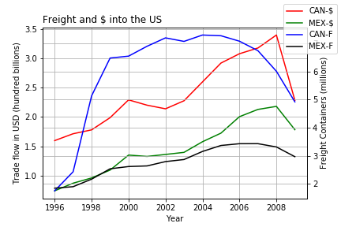

Slide 7
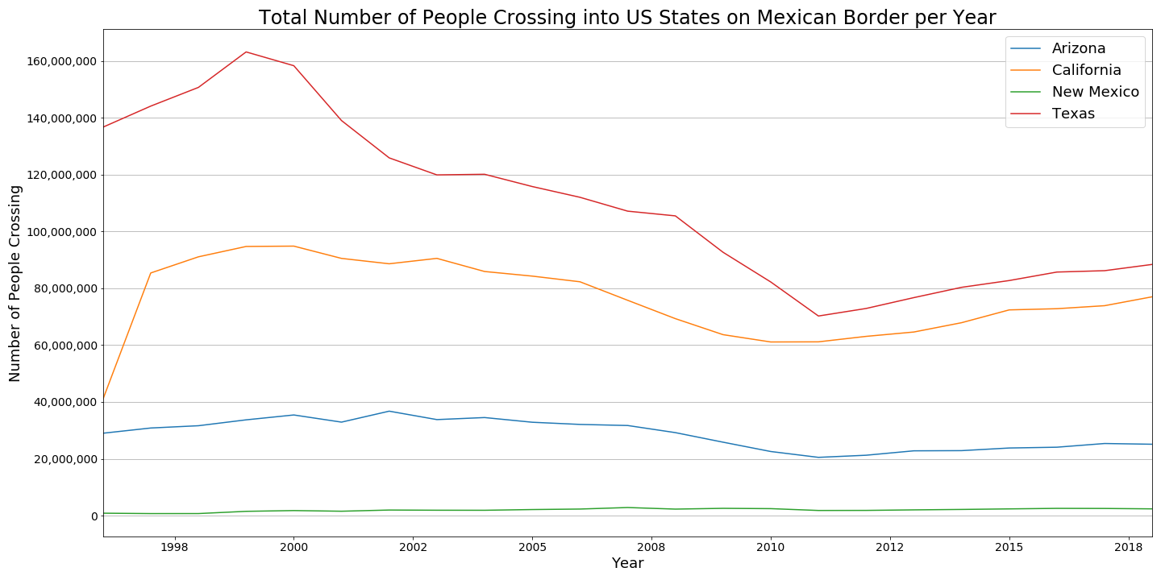

Slide 8
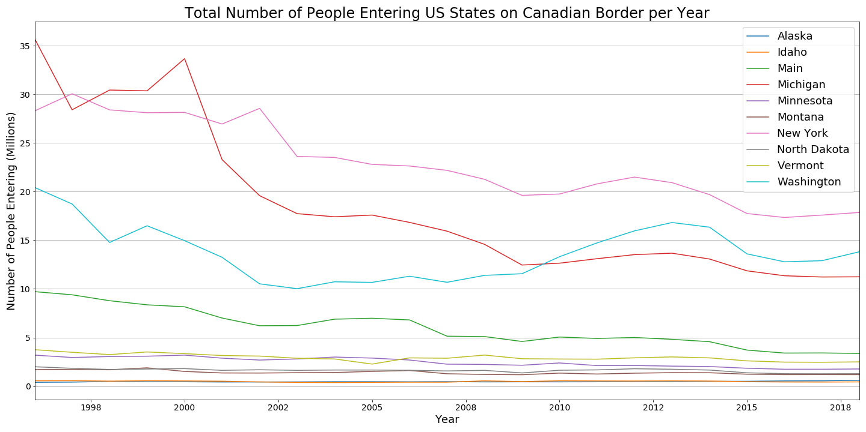

Slide 9
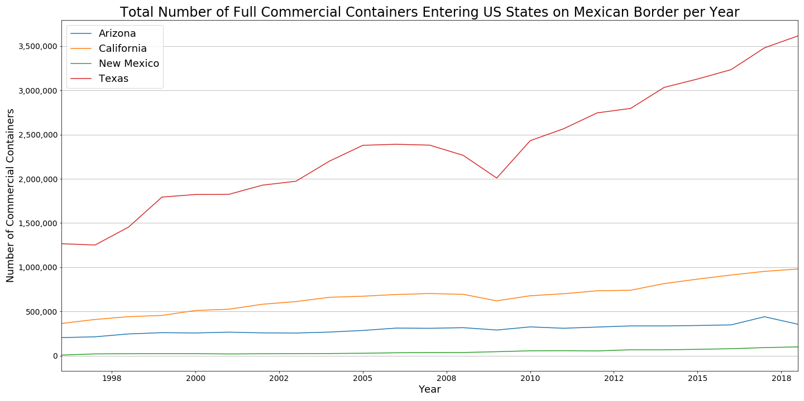

Slide 10
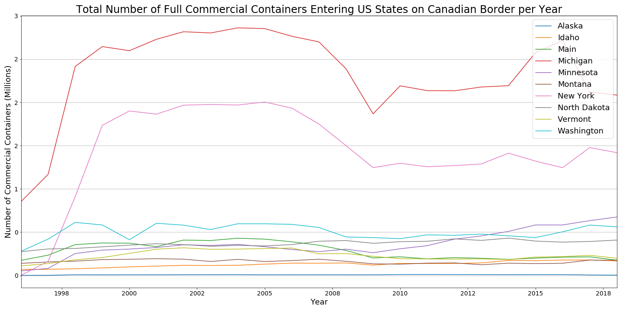

Slide 11
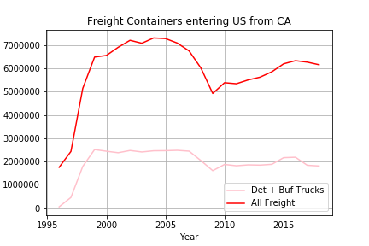

Slide 12
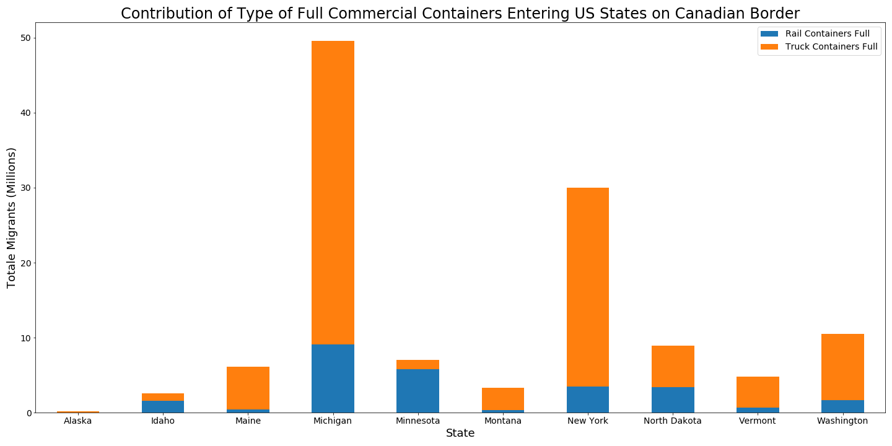

Slide 13
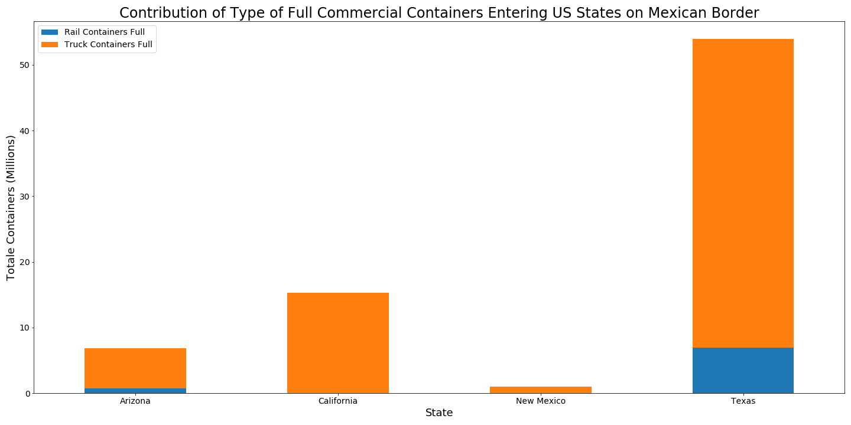

Slide 14
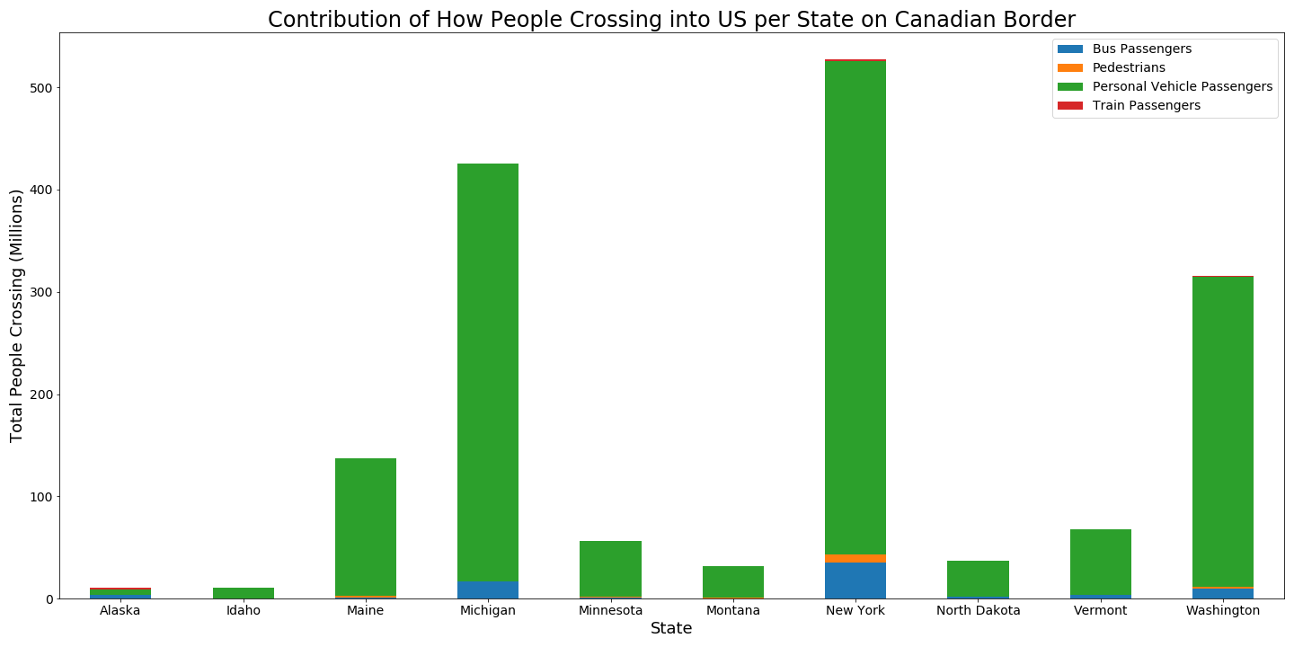

Slide 15
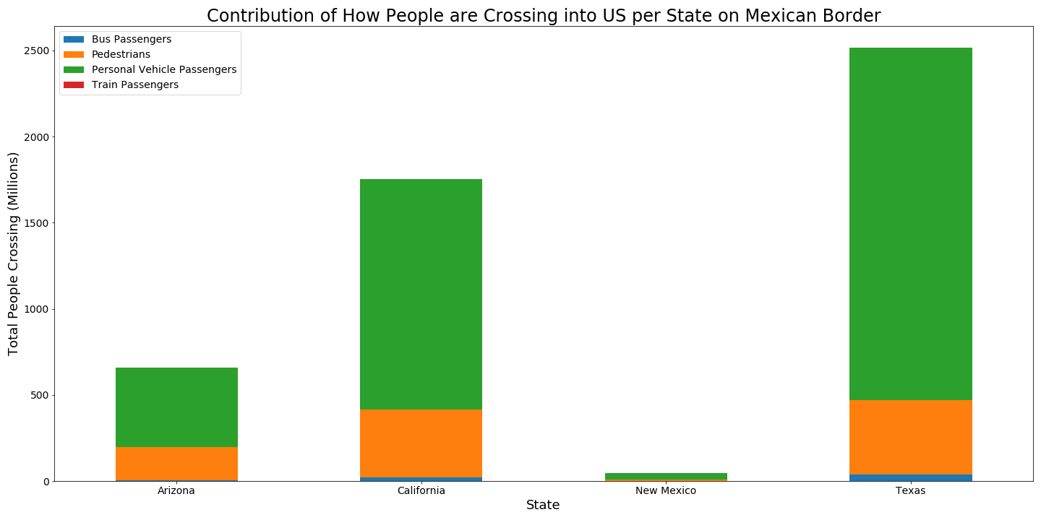

Slide 16
Discussion
Findings
Individuals enter the US more often at the Mexican than Canadian border (2-4x yearly)
Individuals entering from Mexico declined steadily from 2000 to 2011, but has been increasing since.
Far more people than shipping containers arrive from both countries
More people arrive from Mexico than from Canada, but the opposite is true for freight.
More money enters the US as a result of trade with Canada than with Mexico
In 2009, the amount of freight and people entering the US declined sharply.
Truck containers entering at Buffalo, NY and Detroit, MI account for the largest increase in freight after the enactment of NAFTA.

Slide 17
Post mortem
Additional questions that arose
What exactly did the US begin importing from Canada after the enactment of NAFTA?
How else might the surge in truck containers arriving at Detroit and Buffalo be explained?
What caused the decline in individuals crossing the Mexican border into the US from 2000-2010?

Slide 18
Questions

